Slide 1
An introduction to Engineering Economics

Slide 2
What is Economics ?
Economics is the science of scarcity.
Scarcity is the condition in which our wants are greater than our limited resources.
Since we are unable to have everything we desire, we must make choices on how we will use our resources.
In economics we will study the choices of individuals, firms, and governments.
Economics is the study of _________.
choices

Slide 3
Economics Defined
Economics is a social science which is concerned with the efficient use of limited resources to achieve maximum satisfaction of economic wants.
(Study of how individuals and societies deal with scarcity)

Slide 4
Engineering Economy
It deals with the concepts and techniques of analysis useful in evaluating the worth of systems, products, and services in relation to their costs

Slide 5
Engineering Economy
It is used to answer many different questions
  Which engineering projects are worthwhile?
    Has the mining or petroleum engineer shown that the mineral or oil deposits is worth developing?
  Which engineering projects should have a higher priority?
    Has the industrial engineer shown which factory improvement projects should be funded with the available dollars?
  How should the engineering project be designed?
    Has civil or mechanical engineer chosen the best thickness for insulation?

Slide 6



Scarcity Problem
Food, clothing, shelter etc.
Land, Labor, Capital, Entrepreneur
Rent, Wages, Interest, Profits
Unlimited Human Wants
Limited Resources

Slide 7
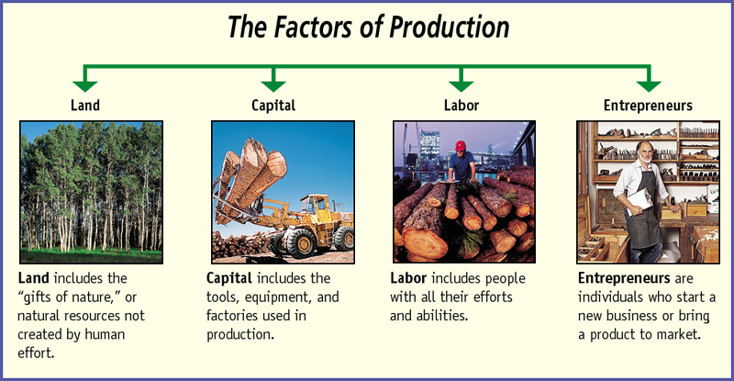

Slide 8










.
1. Land (natural resources)
A. In the earth - coal, oil, fossil fuels, etc.
B. On the earth – vegetation and water
C. In the atmosphere – sun, wind, and rain
[Land is the starting point of all production.”
“Stuff” from which everything is made.
Water
Wind
“Gifts of Nature”
Sun
Fossil fuels

Slide 9







.
2. Labor [human resources]
A. Physical –“muscle-power” of human beings]
B. Intellectual –“brain-power” of human beings]
“Hired Help”

Slide 10






.
3. Capital
A.REAL CAPITAL
[tools, machinery, & factories]
Can produce something
directly with these
B.FINANCIAL CAPITAL
[stocks, bonds, and money]
Can’t produce anything
directly with these

Slide 11
4.Entrepreneurship
Entrepreneurship – starting a new business or introducing a new product. He introduces the product or starts the new business. He combines land, labor, and capital to produce products.
The resource owners receive rent [for the use of their land;
wages [for their labor];
interest [payment for financial capital], and
profits [for their entrepreneurial ability].

